Slide 1
Decompose Beam Gain Using TDH Functions
Xinze (Sunny) Guo
Space Science Laboratory, UC Berkeley

Slide 2
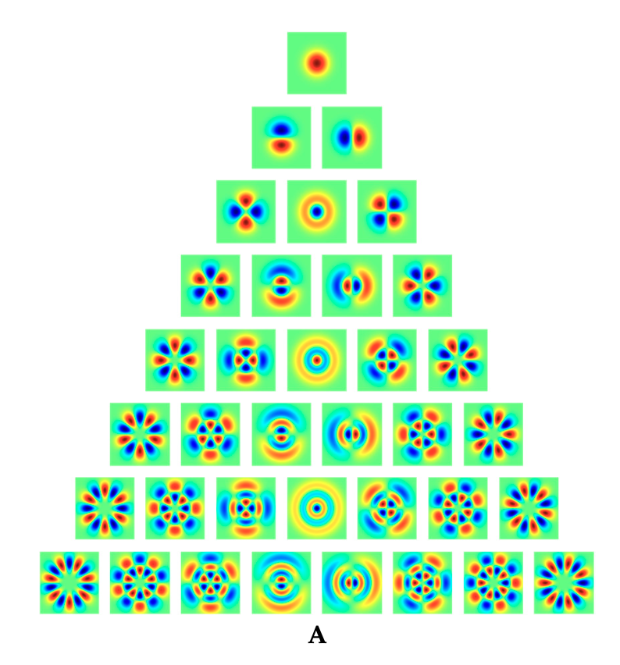
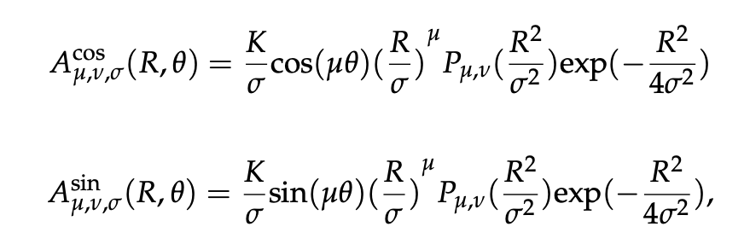
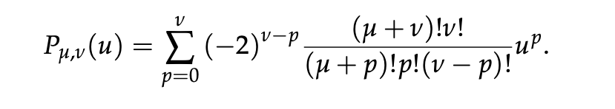
Two-dimensional Hermite functions (TDH)
Rank
0
1
2
3
4
5
6
7
r = μ + 2ν
σ : size
K: Normalization constant

Slide 3
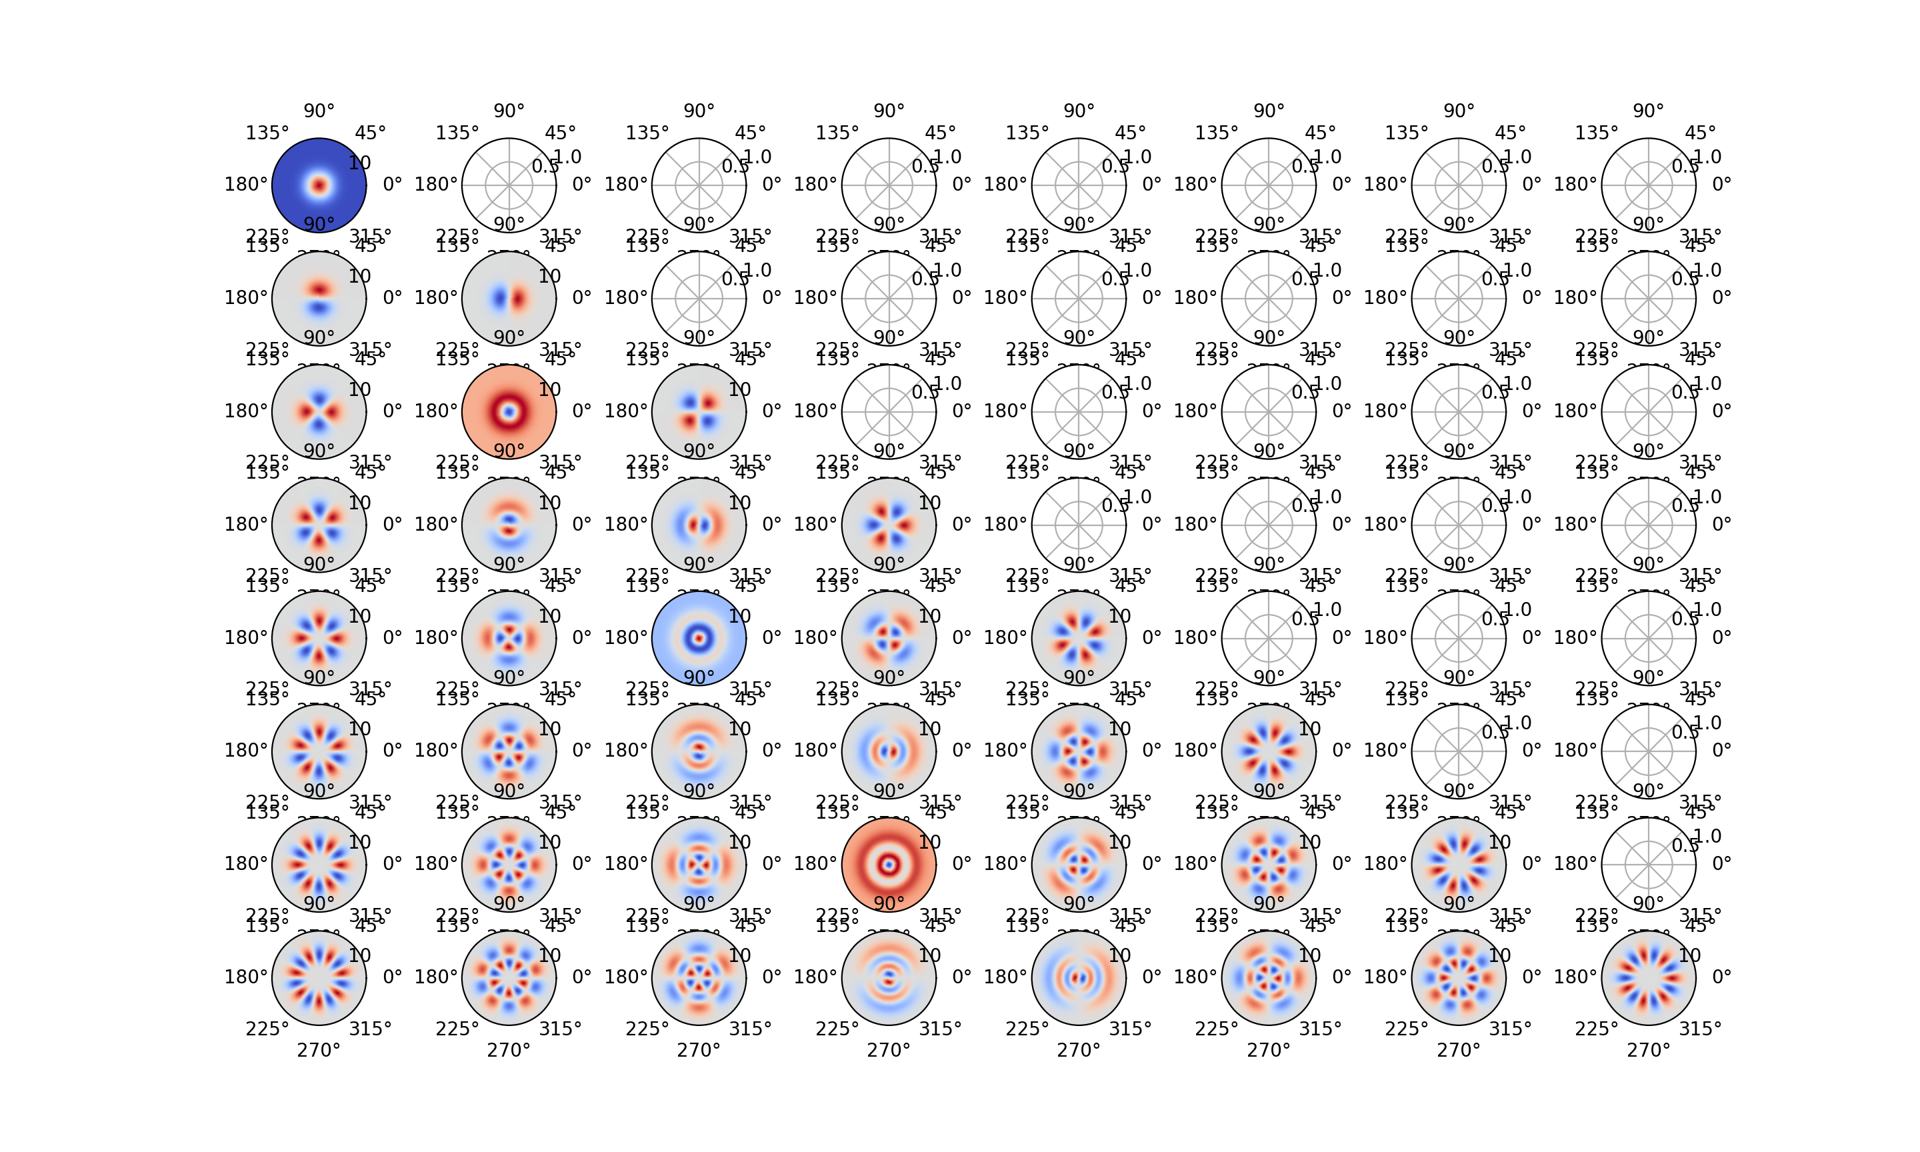
TDH Functions

Slide 4

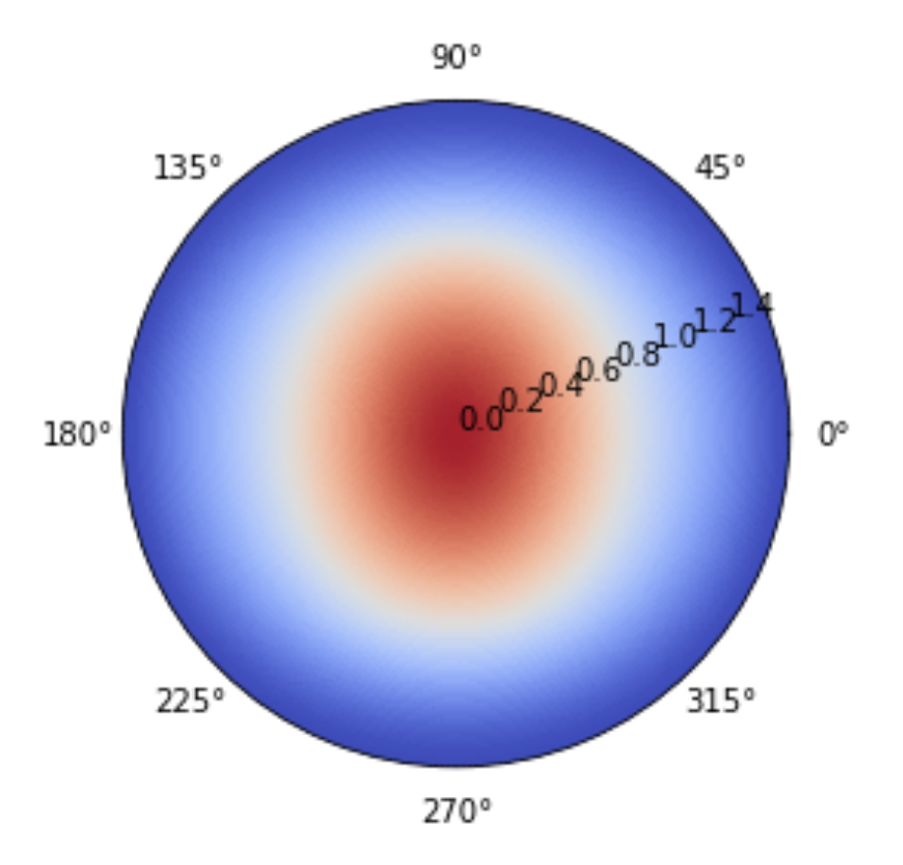
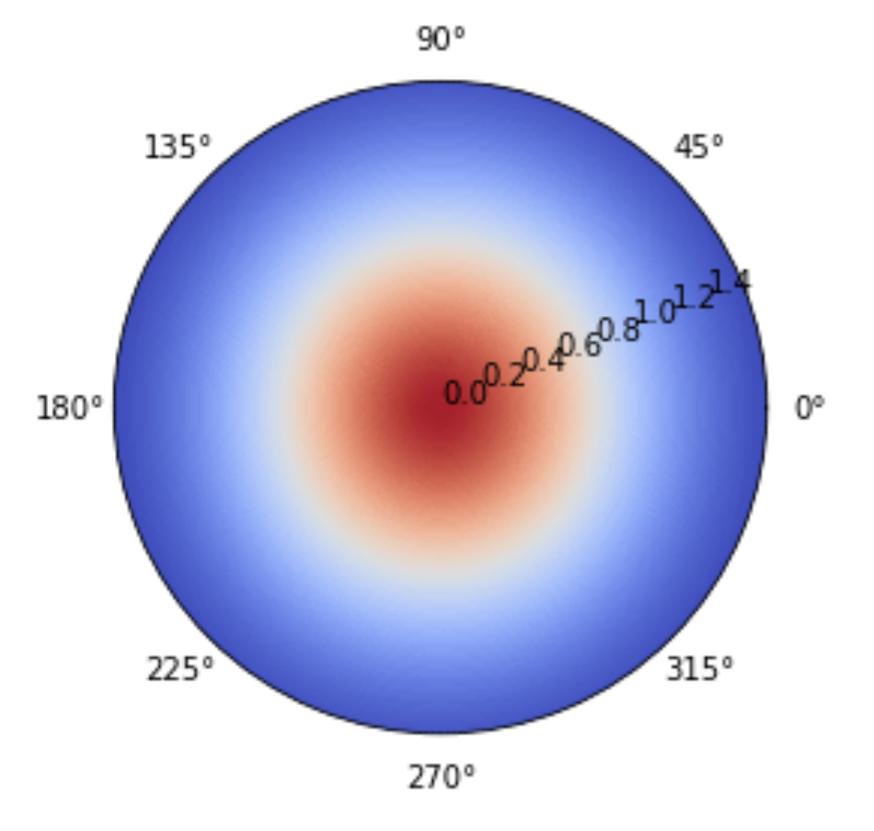
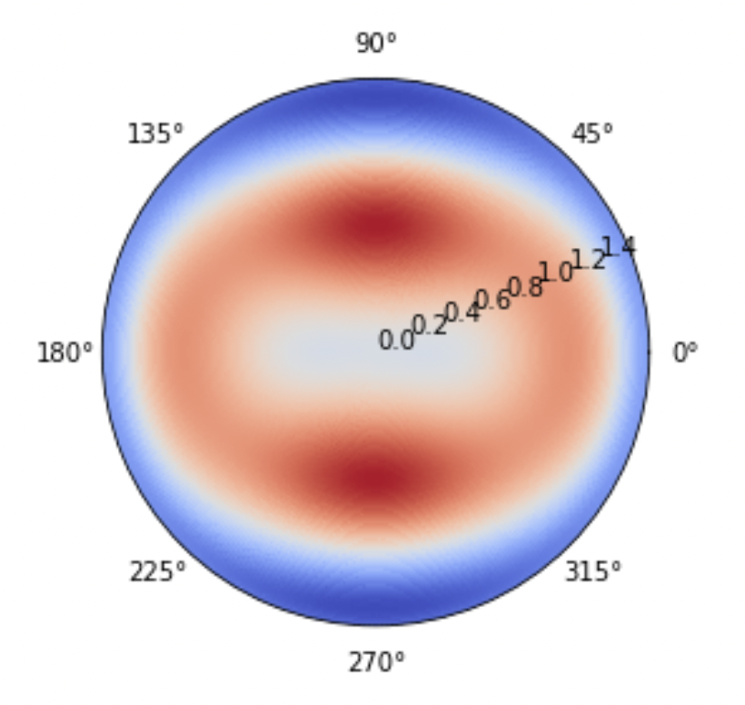
Fit a 2D Gaussian Using UltraNest
A = 0.5353; sigx = 0.6612; sigy = 0.7030
Beam Gain at Frequency 25 MHz
2D Gaussian Model
Residuals

Slide 5
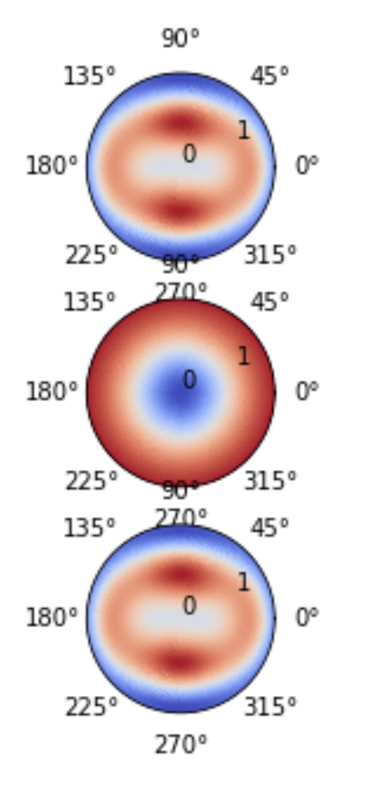
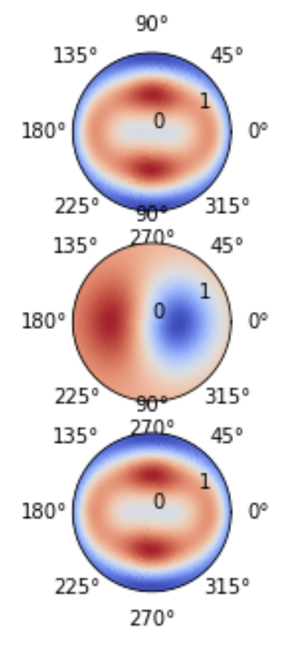
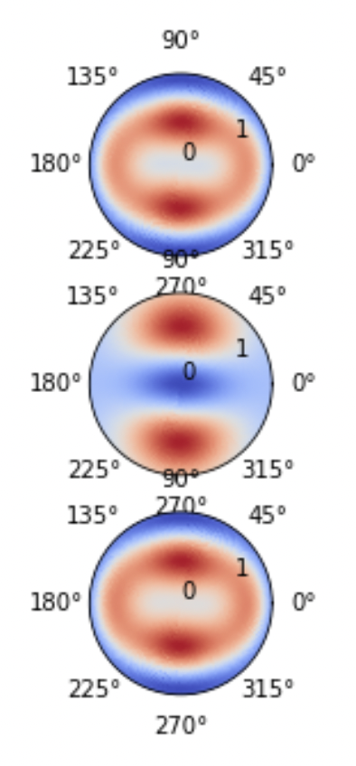
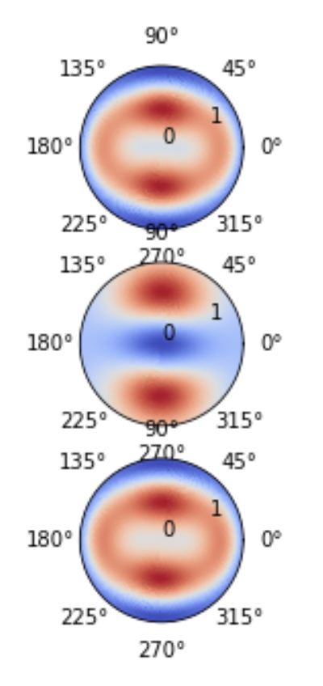
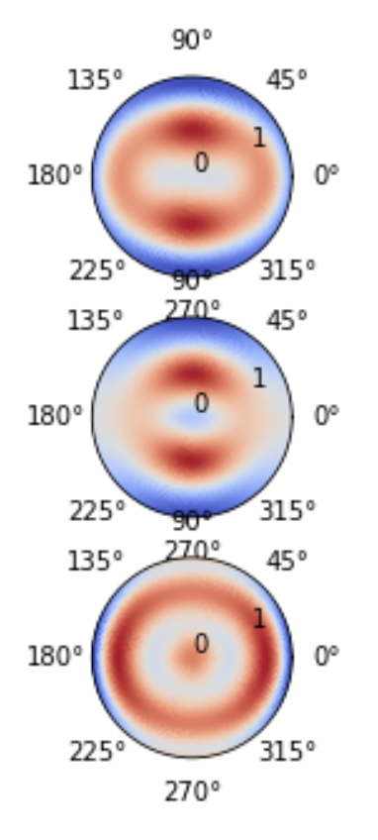
Fit Residuals Using TDH Functions
Rank 0 (1) Rank1(3) Rank2(6) Rank3(10) Rank4(15)
Data
Model
Residual
Percentage
3.60%
3.60%
3.59%
3.59%
1.35%

Slide 6
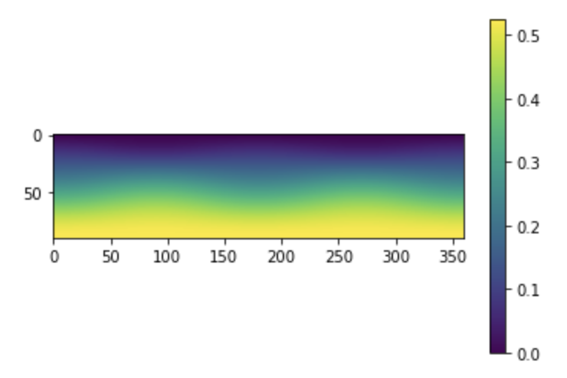
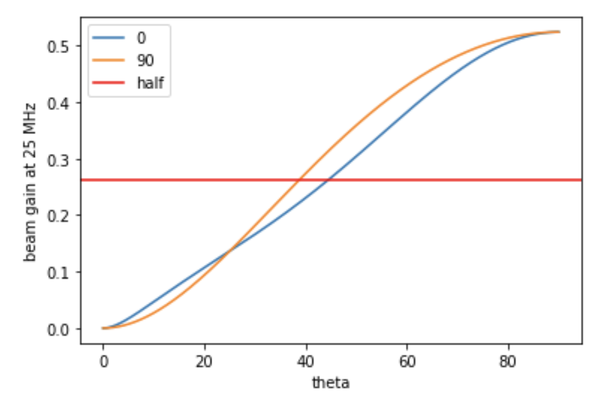
Change Axis
Compressing -> Circular
Gaussian Ratio = sigy / sigx = 0.7030 / 0.6612 = 1.06
CubicSplineRatio = 1.17

Slide 7
Thank you!

Slide 8
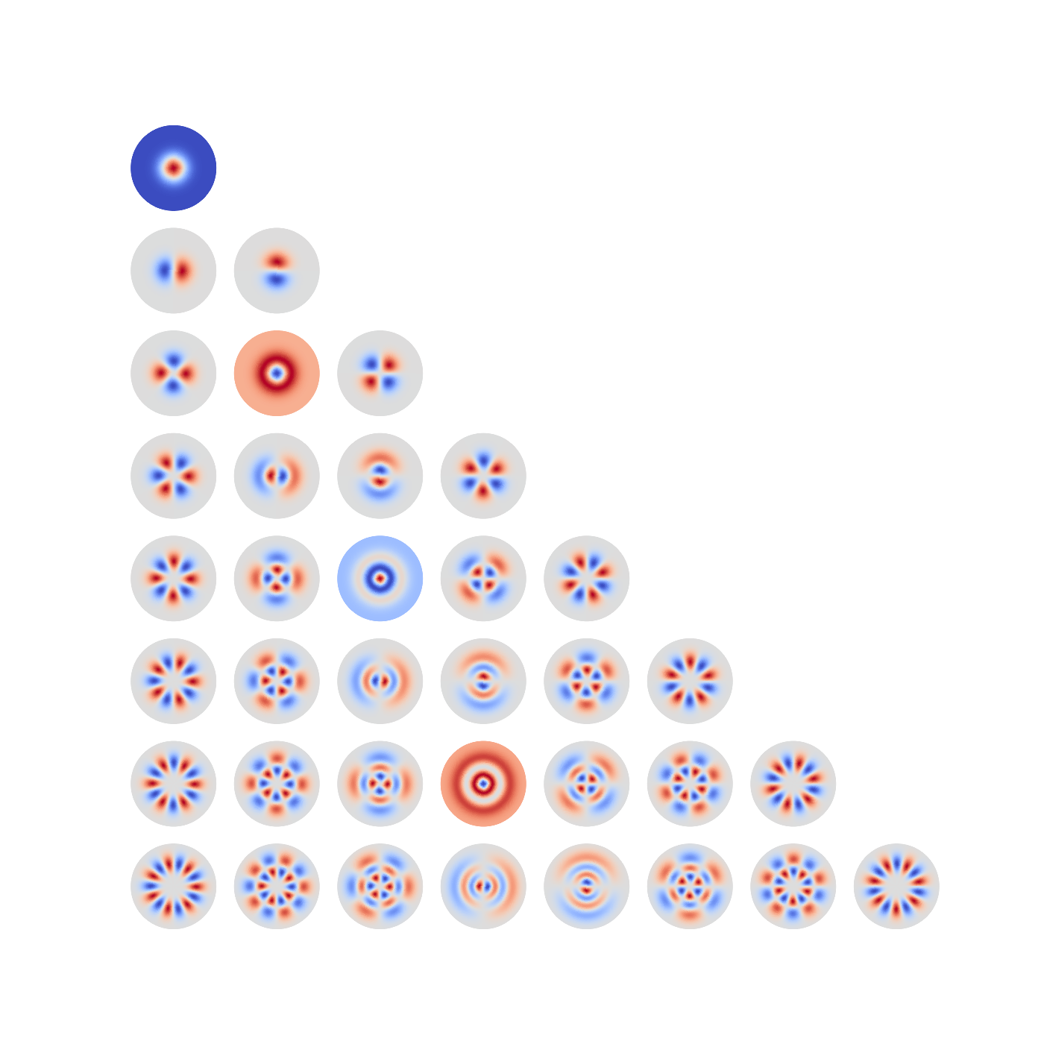
Cosine
Sine

